Slide 1
Search Engine: An Introduction
Prashant Soni
Assistant Professor
United Group of Institutions

Slide 2
Question 1
How many computers are in the world?

Slide 3
Question 1
How many computers are in the world?
Ans: : Over 40 million (Approx)

Slide 4
Question 2
How many of them are Web servers?

Slide 5
Question 2
How many of them are Web servers?
Ans: Over 3 million.

Slide 6
Question 3
How many Web pages in the world?

Slide 7
Question 3
How many Web pages in the world?
Ans: Over 350 million.

Slide 8
Question 4
What is the most popular formats of Web documents?

Slide 9
Question 4
What is the most popular formats of Web documents?
Ans: HTML, GIF, JPG, ASCII files, php, Postscript and ASP.

Slide 10
Question 5
What is the average size of Web document?

Slide 11
Question 5
What is the average size of Web document?
Ans: : Mean: 5 Kb; Median: 2 Kb.

Slide 12
Question 6
How many queries does a search engine answer every day?

Slide 13
Question 6
How many queries does a search engine answer every day?
Ans: Tens of millions.

Slide 14
Web: Characteristics
Huge (1.75 terabytes of text)
Allow people to share information globally and freely
Hides the detail of communication protocols, machine locations, and operating systems
Data are unstructured
Exponential growth Increasingly commercial over time (1.5 % .com in 1993 to 60% .com in 1997)

Slide 15
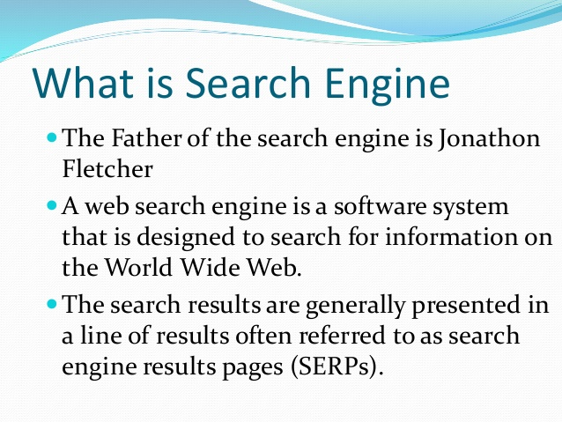
What is Search Engine

Slide 16
Difficulties of Building a Search Engine
Build by Companies and hide the technical detail
Distributed data High percentage of volatile data
Large volume
Unstructured and redundant data
Quality of data
Heterogeneous data
Dynamic data
How to specify a query from the user
How to interpret the answer provided by the system

Slide 17
Information Retrieval
Search Engine is in the field of IR
Searching authors, titles and subjects in library card catalogs or computers
Document classification and categorization, user interfaces, data visualization, filtering
Should easily retrieve interested information
IR can be inaccurate as long as the error is insignificant
Data is usually natural language text, which is not always well structured and could be semantically ambiguous
Goal: To retrieve all the documents which are relevant to a query while retrieving as few non-relevant documents as possible

Slide 18
User Problems
Do not exactly understand how to provide a sequence of words for the search
Not aware of the input requirement of the search engine.
Problems understanding Boolean logic, so the users cannot use advanced search
Novice users do not know how to start using a search engine
Do not care about advertisements ? No funding
Around 85% of users only look at the first page of the result, so relevant answers might be skipped

Slide 19
Types of Search Engines
Search by Keywords (e.g. AltaVista, Excite, Google, and Northern Light)
Search by categories (e.g. Yahoo!)
Specialize in other languages (e.g. Chinese Yahoo! and Yahoo! Japan)
Interview simulation (e.g. Ask Jeeves!)

Slide 20
Web Crawlers
Software agents that traverse the Web sending new or updated pages to a main server where they are indexed
Also called robots, spiders, worms, wanders, walkers, and knowbots
The 1st crawler, Wanderer was developed in 1993
Not been publicly described
Runs on local machine and send requests to remote Web servers
Most fragile application
Breath-first and depth-first manner
Avoid crawling same pages
Web pages change dynamically
Invalid links: 2% to 9%
Fastest crawlers are able to traverse up to 10 million pages per day

Slide 21
Indices
Use inverted files Inverted file is a list of sorted words
Each word points to related pages
A short description associates with each pointer 500 bytes for description and pointer
Store answer in memory
Reduce size of files to 30%
Use binary search for searching for a single keyword
Multiple keyword searching requires multiple binary search independently, then combine all the result
Phrase search is unknown in public
Phrase search is to search words near each other

Slide 22
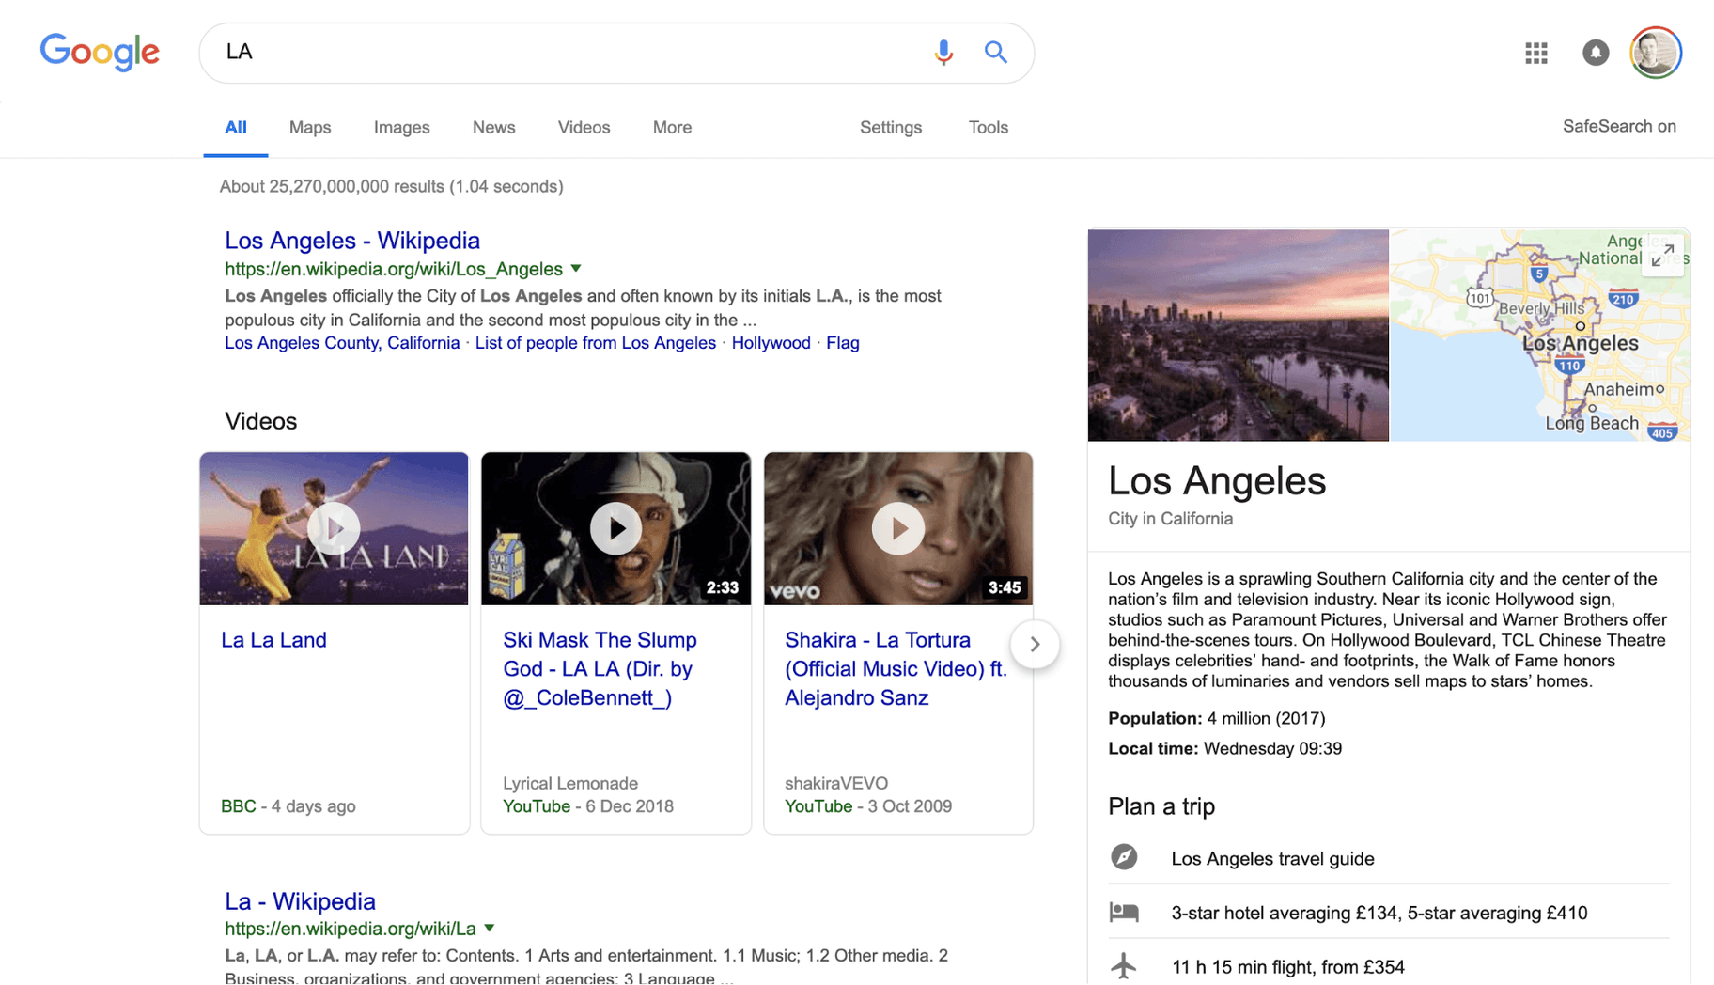
Best Search Engine
The Best Search Engine in The World: Google
Worldwide Search Engine Market Share: 92.18%

Slide 23
Top Search Engines in The World

Slide 24
Top Search Engines in the World
The Best Search Engine in The World: Google.
Search Engine #2. Bing.
Search Engine #3. Baidu.
Search Engine #4.Yahoo!
Search Engine #5. Yandex.
Search Engine #6. Ask.
Search Engine #7. DuckDuckGo.
Search Engine #8. Naver.

Slide 25
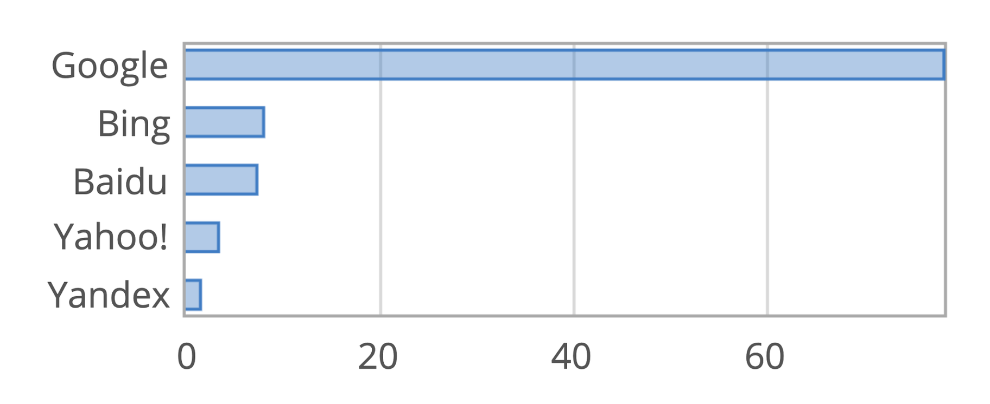
Top Search Engines in the World: Market Share

Slide 26
Google Crawler
Fast distributed crawling system
How does it work?
Peak speed: > 100 pages/sec or 600k per sec for 4 crawlers
Use DNS cache to avoid DNS look up
Each connection possible states:
Looking up DNS
Connecting to host
Sending request
Receiving response
Crawling problems

Slide 27
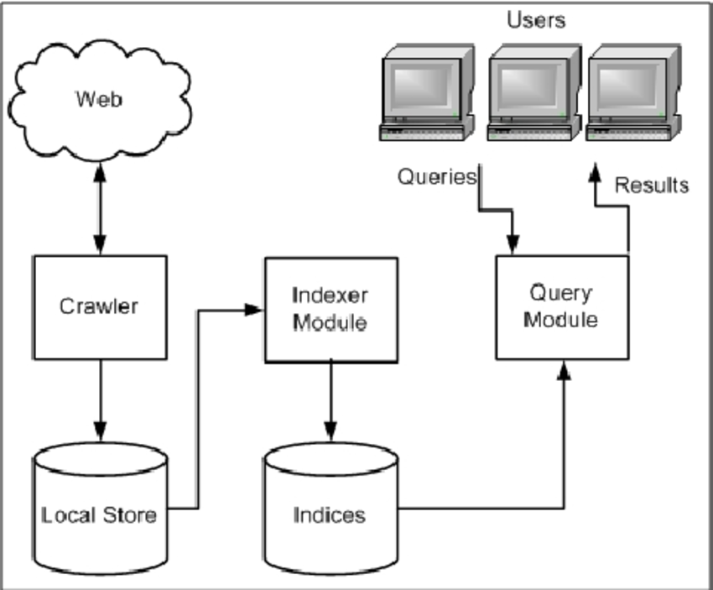
Search Engine Architecture

Slide 28
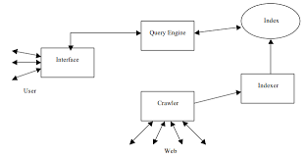
AltaVista Architecture

Slide 29
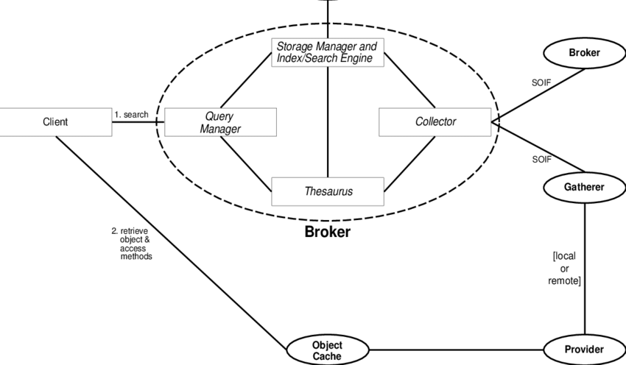
Harvest Architecture

Slide 30
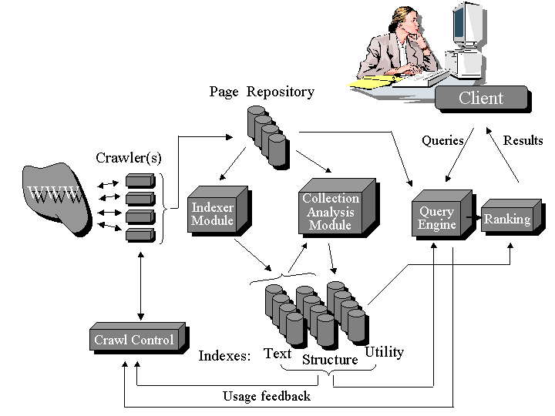
Google Architecture

Slide 31
User Interfaces: Query Interface
A box is entered a sequence of words (AltaVista uses union, HotBot uses intersection)
Complex query interfaces (e.g. Boolean logic, phrase search, title search, URL search, date range search, data type search)

Slide 32
User Interfaces: Answer Interface
Relevant pages appear on the top of the list
Each entry in the list includes a title of the page, an URL, a brief summary, a size , a date and a written language

Slide 33
Web Directories
Also called: catalogs, yellow pages, subject directories
Hierarchical taxonomies that classify human knowledge
First level of taxonomies range from 12 to 26
Popularities: Yahoo!, eBLAST, LookSmart, Magellan, and Nacho.
Most allow keyword searches
Category services: AltaVista Categories, AOL Netfind, Excite Channels, HotBot, Infoseek, Lycos Subjects, and WebCrawler Select

Slide 34
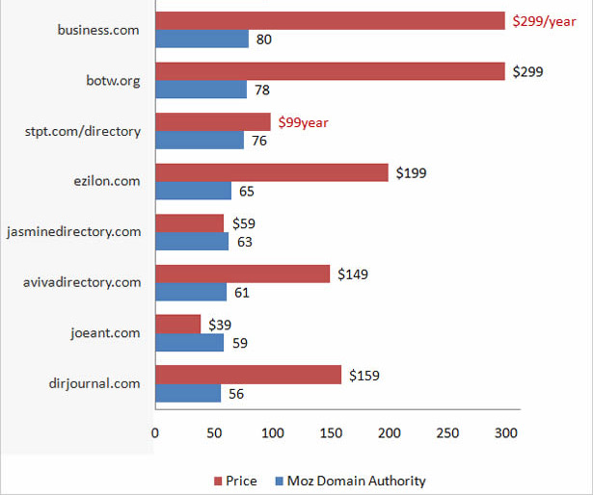
Top Web Directories of the World

Slide 35
Web Pages: Ranking
Not publicly available
Do not allow access to the text, but only indices
Sometimes too many relevant pages for a simple query
Hard to compare the quality of ranking for two search engines
PageRank, Anchor Text

Slide 36
PageRank
Used by WebQuery and Google
The equation: PR(a) = q (1 - q)? (i = 1 .. N) PR(pi )/C(pi )
Google simulates users using the search engine to rank documents
Google uses citation graph (518 million links)
Google computes 26 million in a few hours
Many pages point to the result page ?
High ranking
Some high-ranking pages point to the result page ?
High ranking

Slide 37
Anchor Text
Most search engines associate the text of a link with the page that the link is on
Google is the other way around
Advantages: more accurate descriptions of Web pages and document can be indexed
259 million anchors
Idea was originated by WWWW (World Wide Web Worm) Other Feat

